Slide 1
Integrated Pest Management Strategies for Suitable Control Measures in Sugarcane
Presented By: Shehzad Sultan
Sr. DGM (Cane)
SHEIKHOO SUGAR MILLS LIMITED, KOT ADDU

Slide 2
INTRODUCTION
The increasing population of the world and increasing demands for food and other agricultural products.
Insects are the largest and more diverse group of animals and found almost everywhere in the environment.
Pests attack economically important plant parts resulting in the death or lower yield of the plant.
The term integrated pest management (IPM) was synthesized and published by a number of authors who were gaining the awareness about the negative role of insecticides.
This study will provide technical knowledge to the field staff and farmers for the implementation of IPM for sustainable production of sugarcane crop in Pakistan.
Year | Sugarcane Area (Hectare) | Production (tons) | Yield (Tons/ha) | Sugar Recovery (%)
2021-2022 | 1,259,594 | 88,615,674 | 70.35 | 9.87
(PSMA annual report, 2021-22)

Slide 3
WHAT IS INTEGRATED PEST MANAGEMENT (IPM)?
Integrated Pest Management (IPM) is an approach to control pests that promotes the use of a combination of techniques to manage pest populations in a sustainable and environmentally-friendly manner.
The IPM approach takes into account the biology and behavior of pests, as well as their interactions with the environment and surrounding ecosystem.
IPM is an approach that is gaining popularity, particularly in the agriculture industry, as it reduces the reliance on chemical pesticides, which can have harmful effects on the environment, as well as on people and wildlife.
The goal of IPM is to manage pests in a way that is effective, economically feasible, and sustainable in the long term.

Slide 4
Integrated Pest Management (IPM) Components
MONITORING: Regular inspections to identify pests and determine their population levels.
IDENTIFICATION: Accurately identifying the pest species, as well as their life cycle, behavior, and habitat.
PREVENTION: Taking steps to prevent pest infestations, such as implementing good sanitation practices.
CULTURAL CONTROL: Using practices that make the environment less favorable for pests, such as crop rotation or planting pest-resistant varieties.
BIOLOGICAL CONTROL: Using natural enemies of pests, such as predators or parasites, to control populations.
CHEMICAL CONTROL: Using pesticides when necessary, but only as a last resort.

Slide 5
Implementing IPM in Sugarcane
The implementation of IPM in sugarcane production involves a holistic approach to control pests. Some of the key elements of an IPM program for sugarcane include:
Monitoring (Pest Scouting): Regular monitoring of the sugarcane crop for signs of pest infestations, as well as tracking the population levels of pests.
Prevention: Good agricultural practices, such as crop rotation and maintaining healthy soil, can help prevent pest infestations.
Biological Control: The use of natural enemies of pests, such as predators and parasites, can be an effective way to control pest populations.
Chemical Control: The use of chemical pesticides is only recommended when other methods have failed, and when the pesticide is deemed safe and effective.

Slide 6
Generation / Active Period of Sugarcane Borers
Name of Borer | No. of Generation in a year | Active Period
Top Borer | 4-5 | Feb-Nov
Stem Borer | 4-5 | Mar-Nov
Root Borer | 3-4 | Apr-Nov
Gurdaspur Borer | 2-3 | Jul-Oct

Slide 7
ETL of Sugarcane Pest
Name of Borer | Economic Threshold Level
Top Borer | 8-10%
Stem Borer | 8-10%
Root Borer | 8-10%
Gurdaspur Borer | 8-10%
Pyrilla | 3 / Leaf
Mites | 10 / Leaf
Termites | 10% Damage
Mealy Bug | 3-5 Adults
Grasshopper (Tokka) | On Appearance
White Fly | 10 / Leaf
Black Bug | 10 / Sheeth
Roddents | 5 Live Burrows / Acre

Slide 8
Production Losses
Name of Pest | % Reduction in Cane Yield (tons/ha) | Reduction in Sugar Recovery %
Top Borer | 21-37 | 0.2 - 4.1
Stem Borer | 31-33 | 1.7 – 3.07
Root Borer | 32-35 | 0.3 – 2.9
Gurdaspur Borer | 25-30 | 0.3 – 2.1
Pyrilla | 14.7 | 2.0 – 3.0
Mites | 16-20 | 0.2 – 1.3
Termites | 18-22 | 2.7 - 4.5
Grasshopper (Tokka) | 37-40 | 2.1 – 4.3
White Fly | 80 | 1.4 – 1.8
Black Bug | 31 | 0.1 – 2.8
Roddents | 15-20 | 0.1 – 1.1
Reference: Sugarcane Pests & their Management (Srikanth, et. al., 2001)

Slide 9
Chemical Control of Sugarcane pests
 | Name of Pest | Chemical
Chewing Pest | Top Borer | Fipronil 25% Ec (60 gm / acre) Chlorantraniliprole 40wg (8 kg / acre) Bifenthrine 10% Ec (500 ml / acre) Cypermethrine 10% Ec (1L / acre) Lambda Cyhalothrine 2.5 % (1 L / acre) Profenofos 50% Ec (1200 ml / acre) Chloropyrifos 40% Ec (2 L / acre)
 | Stem Borer
 | Root Borer
 | Gurdaspur Borer
 | Termites
 | Grosshopper (Tokka)
Sucking Pest | Pyrilla | Fipronil 25% Ec (60 gm / acre) Chloropyrifos 40% Ec (2 L / acre) Obiron 24 Sc (300 ml / acre for Mites) Lambda Cyhalothrine 2.5 % (1 L / acre) Cypermethrin 10% Ec (1 L / acre) Bifenthrine 10% Ec (500 ml / acre)
 | Mites
 | Mealy Bug
 | White Fly
 | Black Bug
Roddents | Rats, Pigs, Jackals | Aluminium phosphide

Slide 10
Bio-control Agents
Insects | Biological agents
Root borer Stem borer Gurdaspur borer Top borer | Trichogramma chilonis-Egg parasite (20-25 cards/acre from March to September fortnightly) Only 40% control of top borer due to the covering with orange tuft of anal hairs of female.
Pyrilla | Tetrastichus pyrillae (Egg parasite naturally present). Epiricania (Predator-naturally present).
White Fly Pyrilla | Chrysoperla carnea-Predator (Green lacewing)
Mealybug | Mealybug destroyer-Predator (Cryptolaemus montrouzieri)

Slide 11
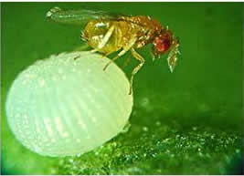
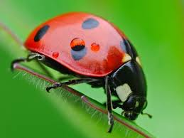
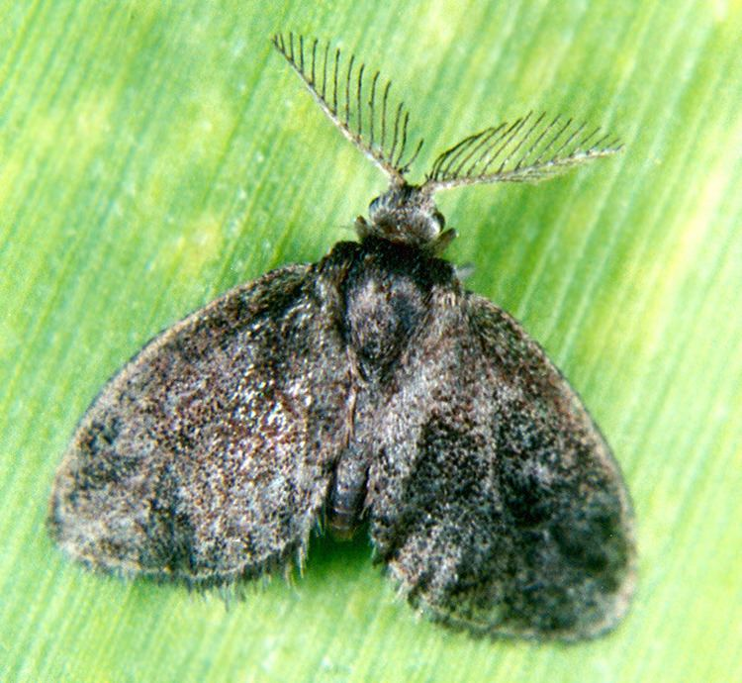
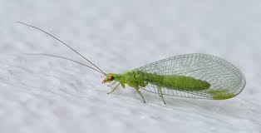
Parasites and Predators of Sugarcane Pests
Trichogramma chilonis
Coccinella septempunctera (Lady Bird Beetle)
Epiricania melanoleuca
Chrysopa sp.

Slide 12
Crop Stage Wise IPM in Sugarcane
Management | Activity
Pre-Sowing and after sowing
Nutrients | Soil test based nutrient recommendations should be followed for use of NPK. Apply organic manures/press mud @ 8 to 10 tons/acre Sugarcane trash can be used as a mulch. Spread trash with 20 Kg urea and 25 Kg SSP. Crops like jantar are grown as green manure crop.
Weeds | Cultural control: Adopt proper crop rotation & follow recommended agronomic practices. The initial 30-120 days is the critical period of weed competition. Therefore the weed management practice should be ensured for the first 3-4 months. Being wildly spacing crop, tractor drawn implement should be used for intercultural operations at 30 and 60 days after sowing Chemical control: Use of pre-emergence weeds like Dual gold by Syngenta, Click by Evyol, etc Use post-emergence @ 2 liters of Konnect (Gangvi) per acre.

Slide 13
Crop Stage Wise IPM in Sugarcane
Management | Activity
Soil & Seed born disease insect pests | Cultural control: Select tolerant / resistant varieties Select the healthy seed cane pure field. Crop like potato, mustard, wheat and winter vegetables can be grown as inter crop during autumn planted sugarcane
Tillering Stage
Early shoot and root borer | Cultural control: Deep summer ploughing, Inter culture Timely irrigation, Light earthing up of crops three months after planting In ratoon crop mulching with trash reduce shoot borer attack Mechanical control: Use of pheromone traps @ 4-5/acre for monitoring Remove and destroy the dead hearts along with larvae Installation of light trap with exit option for natural enemies @ 1 per acre

Slide 14
Crop Stage Wise IPM in Sugarcane
Management | Activity
Early shoot and root borer | Biological control: Release Trichogramma chilonis @ 10,000/acre @ 10 days interval. Chemical control: Reagent (Fipronil) @ 1 pack (30 gram) in 100 liters of water/acre or Chlorpyrifos @ 500-600 ml in 100 liters of water/acre Vertako (Chlorantraniliprole) @ 80 gram in 100 liters of water/acre
Top Shoot borer | Mechanical control: Collection & destruction of egg mosses, adult moths and destruction of dead hearts Use of pheromone traps @ 4-5/acre for monitoring coinciding with brood emergence. Installation of light trap with exit option for natural enemies @ 1/ acre Biological control: Release of Trichogramma spp. @ 10,000/acre 2-3 times at 10 days interval. Chemical control: Vertaco (Chlorantraniliprole 40 wg) @ 80 gram in 100 liters of water/acre Chlorpyrifos @ 2 liters/acre through flooding

Slide 15
Crop Stage Wise IPM in Sugarcane
Management | Activity
Black Bug | Chemical control: Use of fertera 4 kg per acre
Scale Insects | Cultural control: Use resistant/tolerant varieties. Select the healthy and pest free setts for planting. Keep the fields and bunds free from weeds. Avoid water stagnation in the field for the longer period. Physical control: Detrash the crop at 150th and 210th day of planting. Biological control: Release of Chrysopa as predators. Chemical control: Perenifos / curacron @ 1 liter in 100 liters of water per acre

Slide 16
Crop Stage Wise IPM in Sugarcane
Management | Activity
Cane Formation Stage
Pyrilla | Cultural control: Avoid late application of nitrogenous fertilizers. Collect and put egg masses in cage to facilitate emergence of parasitoids. Removal and destruction of lower dried leaves. Biological control: Release of 3,200 to 4,000 cocoons of Epiricania melanoleuca per acre when 3-5 Pyrilla individuals per leaf are seen. Or use of 2,000 Chrysopa eggs for the control. Chemical control: Chlorpyrifos @ 2 liters/acre through flooding

Slide 17
Crop Stage Wise IPM in Sugarcane
Management | Activity
White Fly | Cultural control: Clipping of infested leaves. Avoid water stress and water logged conditions. Avoid planting in low land areas Mechanical control: Detrashing the pupae bearing leaves and immediately disposing by burning or burying to prevent emergence of adult whiteflies. Use yellow sticky trap. Biological Control: Conserve and augment the natural enemies such as Chrysopa spp., dragonfl y, spider, etc.

Slide 18
Benefits of IPM in Sugarcane Production
The implementation of an IPM program in sugarcane production offers several benefits, including:
Reduced reliance on chemical pesticides
Improved crop yields and quality
Cost savings, as IPM practices can be more cost-effective over time
Sustainable pest management practices

Slide 19
Common Misconception about IPM
Despite the many benefits of IPM, there are some common misconceptions about this approach to control pests. Some of the most common misconceptions include:
IPM is more expensive than traditional pesticide applications
IPM is less effective than traditional pesticide applications
IPM takes too much time and effort. While IPM requires a commitment to monitoring and prevention, the long-term benefits of this approach can far outweigh the time and effort invested.

Slide 20
Conclusion: the Benefits of IPM
Integrated Pest Management is an approach to pest control that promotes the use of a combination of techniques to manage pest populations in a sustainable and environmentally-friendly manner.
Implementation of IPM in sugarcane production can offer many benefits, including reduced reliance on chemical pesticides, improved crop yields and quality, and cost savings.
By understanding the components of IPM and implementing these practices in sugarcane production, growers can promote a sustainable and profitable industry for years to come.

